Slide 1

Final Project
Topic: Formula 1

Slide 2
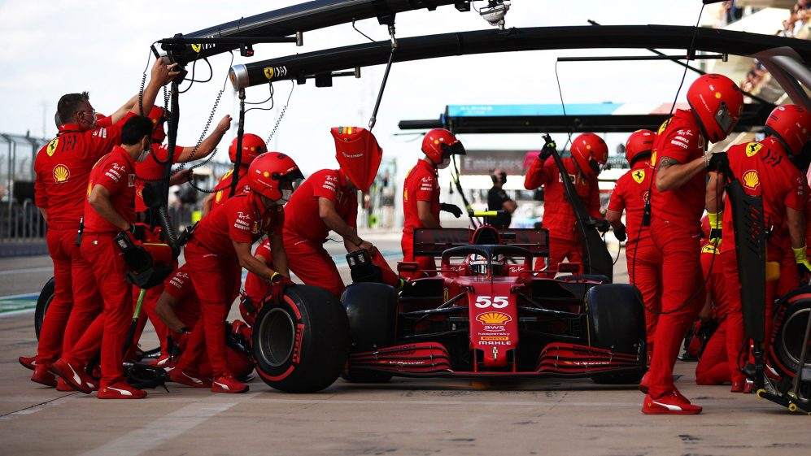
Reason why this topic:
Interesting sport due to many strategies to be a WCC/WDC.

Slide 3
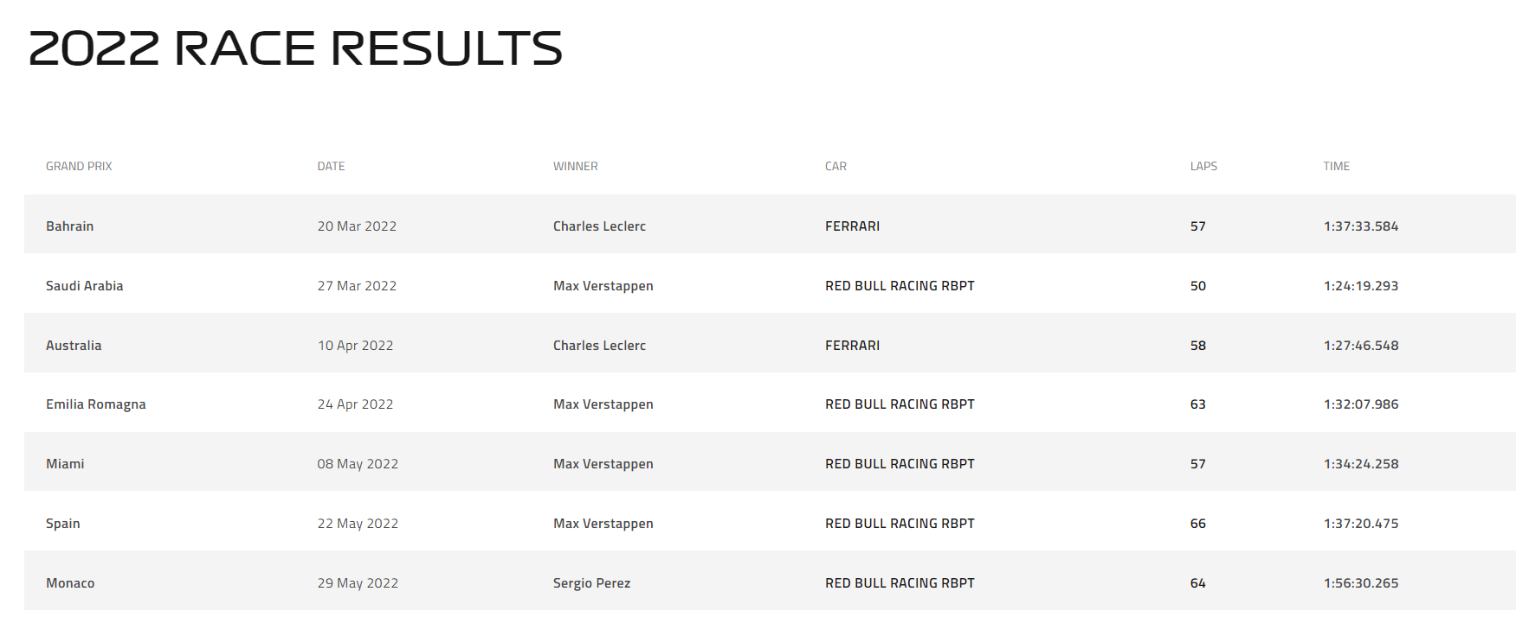
Source of Data
Extracting from their website by web-scraping
Notes:
Should we use this data in our visuals?

Slide 4
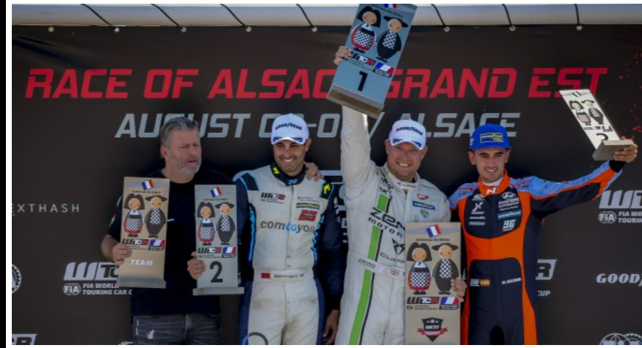
What we’re answering:
Stats data to drive which features make up the top drivers/constructors. Using those features to predict the winning driver/constructors.

Slide 5
Technologies, Languages, tools, algorithms
Python
HTML webscraping
Tableau
MongoDB
Jupyter Notebook
Google colab
Powerpoint
Sklearn
Numpy
Pandas
LightGBM model

Slide 6
Data Extraction: HTML Webscraping
Pulling data from F1 website with webscraping and dependencies: Beautifulsoup, GeckoDriverManager, StaleElementReferenceException.
Pulling individual criteria tables and merging it to one data-frame.

Slide 7
Transform and Cleaning Data
Cleaning the extracted data with pandas and numpy.
Clearing out N/As and enter default time for “NC”, “DQ”.

Slide 8
Database
Loading the data into MongoDB and flask.

Slide 9
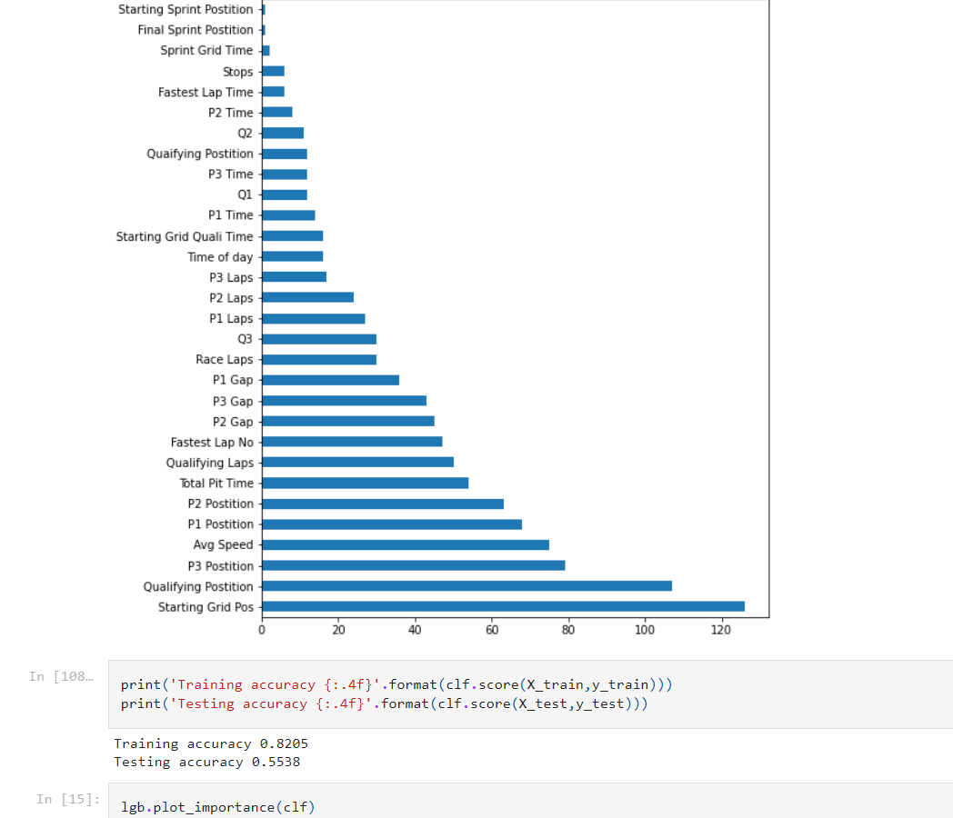
Machine Learning
Using lightgbm model to predict the winner for F1 season 2022.
Features include: Fastest Lap NO, Avg Speed, Race Laps.
The accuracy has improved as well solved some over-fitting issues.
Corrected Features:
Starting Grid Pos, Qualifying Position, P3/P2/P1 Position, Avg Speed, Total Pit Time.

Slide 10
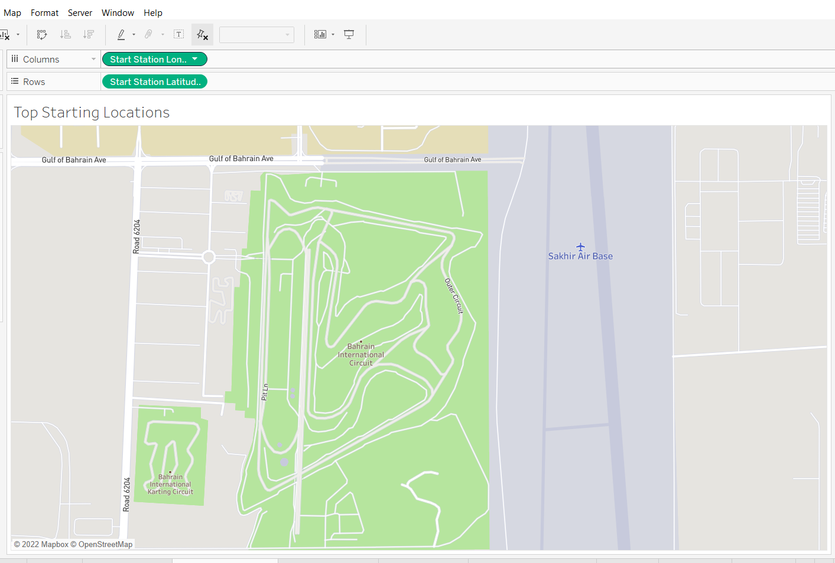
Interactive Tableau
Filters based on countries or drivers with stats.
Bar charts with the total points from 2021 of each driver
Set the interaction where you can hover over each country and when the circuit has started.
In each country, it’ll have the top 3 drivers name.
In the circuit, have all the drivers stats for that race.
When clicked, it will produce tables and charts that are listed in the next slide.

Slide 11
Storyboard
Formulate total averages table of all races for each driver for points, positioning, grid positioning, avg speed, Q times, practice position, num stops, stop total time.
Once we discover the features that meets the linear regression, develop graphs of the specific tables that align the winning factors.

